Slide 1
Problem Statement Title: Personalised Recommendation System
Team Name: GitRack

Slide 2

Team members details
Team Name | GitRack
Institute Name/Names | Indian Institute of Information Technology (IIIT), Bhopal
Team Members > | 1 (Leader) | 2 | 3
Name | Shreem Asati | Ayush Jain
Batch | 2025 | 2025

Slide 3
Deliverables/Expectations for Level 2 (Idea + Code Submission)
Problem Statement 2
Problem Statement: Personalized Product Recommendations
The aim is to enhance user experience by implementing a personalized product ranking system. Your task is to develop an algorithm or model that can generate accurate and relevant product rankings for individual users. The ranking system should consider factors such as user preferences, past interactions, product popularity, and user similarity. It should be able to predict the most suitable products for a user based on their unique characteristics and preferences. You are not provided with a specific dataset for this challenge. Instead, you are expected to design and implement a solution that simulates user interactions and generates personalized rankings. You can define user profiles, product categories, and interaction patterns within your solution. To evaluate the effectiveness of your solution, you should define appropriate metrics for measuring the accuracy and relevance of the rankings. You should also provide a report explaining your approach, describing the algorithms or techniques used, and discussing the strengths and limitations of your solution.

Slide 4
Glossary
Describe/ Expand abbreviations if you have used any in the slides below: Recommendation system: A system that provides personalized product or content suggestions to users based on data about their preferences and behaviors.
Content-based filtering: A recommendation approach that analyzes product attributes and descriptions to identify products similar to those a user has liked in the past.
Collaborative filtering: A recommendation approach that analyzes patterns of ratings or usage by similar users to identify new product suggestions for a user.
User-user collaborative filtering: A collaborative filtering technique that uses similarity between users to make recommendations.
Neighborhood-based collaborative filtering: A collaborative filtering approach that identifies a user's nearest neighbors based on similarity of ratings and makes recommendations using their preferences.
Hybrid recommendation system: A system that combines multiple recommendation techniques together, such as content-based and collaborative filtering.
TF-IDF: Term frequency–inverse document frequency, a numerical statistic that is intended to reflect how important a word is to a document in a collection of documents. Used in content-based filtering.
Cosine similarity: A metric used to calculate how similar two items are by measuring the cosine of the angle between them. Used to identify similarity between products or users.
Rating: A numeric score or preference indicator provided by a user for a product they have purchased or interacted with.
Purchase history: Records of products a user has purchased in the past. Used as an input for making recommendations.
User data: Information about the users of the system, such as user IDs, demographic data, etc. Used as input data.
Product data: Information about the products in the system, such as product descriptions, categories, prices, etc. Used as input data.

Slide 5
Use-cases
List the use cases that are targeted/ identified.
Prioritize the use cases in order of impact (P0, P1, P2 etc)
Based on the code and analysis provided, it seems this recommendation system is designed for an e-commerce platform to provide personalized product recommendations to users. Here are some key points about the use case:
- The system utilizes purchase history, product descriptions, and ratings data to generate recommendations. This allows it to take into account both the content of the products and users' past interactions.
- It implements both content-based filtering (based on product descriptions) and collaborative filtering (based on other users' purchases and ratings) to provide a hybrid recommendation approach.
- The goal is to recommend new products that an individual user is likely to be interested in, based on their unique preferences and tastes.
- Recommendations are generated when a user logs into the platform, providing them with personalized suggestions each time they visit.
- The top recommendations are ranked and scored based on predicted relevance, making it more likely the user will find products they want.
- For users with no purchase history, content-based recommendations based on product descriptions are still provided.
So in summary, this system would be useful for an e-commerce retailer to increase sales by recommending relevant products to users each time they interact with the platform. The hybrid approach allows it to provide personalized suggestions tailored to the individual.

Slide 6
Solution statement/ Proposed approach
Break the problem statement to smaller problems and describe briefly the solutions at an overall and sub-problem level.
Here is a high-level breakdown of the key sub-problems and solutions for this personalized product recommendation system:
Overall Problem: Generate accurate and relevant product recommendations for each user
Sub-problems:
1. Obtain user data:
- Solution: Simulate/create dummy user profiles with attributes like ID, demographics, etc.
2. Obtain product data:
- Solution: Simulate/create dummy products with attributes like descriptions, categories, prices, etc.
3. Obtain user-product interactions:
- Solution: Simulate/create dummy interaction data like purchases, ratings, clicks etc. for users and products.
4. Apply content-based filtering:
- Solution: Use TF-IDF and cosine similarity on product descriptions to find similar products.
5. Apply collaborative filtering:
- Solution: Use user-user collaborative filtering to find similar users and recommend based on their preferences.

Slide 7
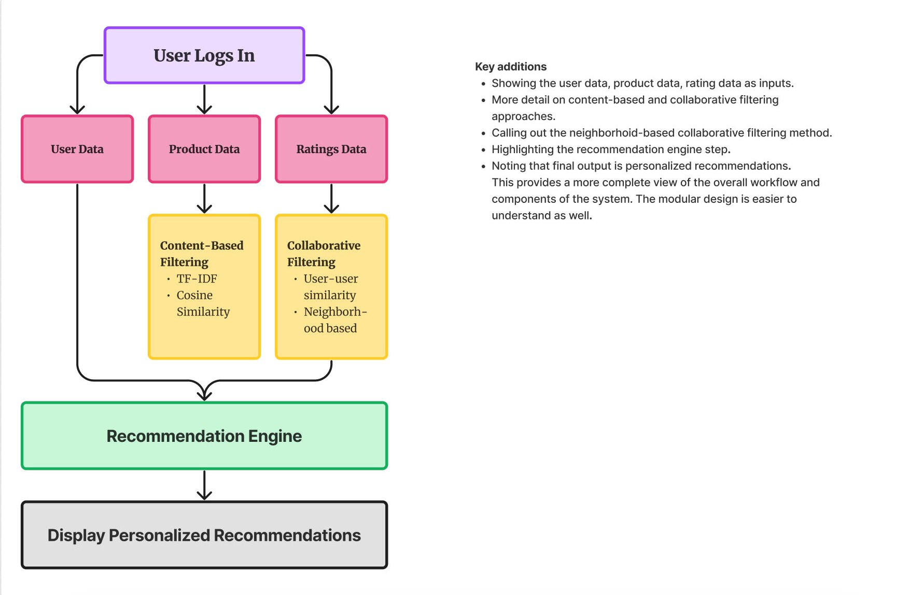

Slide 8
Solution statement/ Proposed approach
6. Combine approaches into hybrid system:
- Solution: Merge content-based and collaborative filtering recommendations into a hybrid recommendation system.
7. Rank recommendations:
- Solution: Score and rank recommendations based on expected relevance for the user.
8. Evaluate system performance:
- Solution: Calculate accuracy metrics like precision and recall to evaluate quality of recommendations.
To summarize, the key solutions are 1) simulating input data 2) applying content and collaborative filtering 3) combining into a hybrid system 4) ranking outputs and 5) evaluating accuracy. The modular design allows solving sub-problems separately before integrating into the overall recommendation system.

Slide 9
Limitations
List the limitations of this design/ solution that is being proposed here
The system utilizes purchase history, product descriptions, and ratings data to generate recommendations. This allows it to take into account both the content of the products and users' past interactions.
It implements both content-based filtering (based on product descriptions) and collaborative filtering (based on other users' purchases and ratings) to provide a hybrid recommendation approach.
The goal is to recommend new products that an individual user is likely to be interested in, based on their unique preferences and tastes.
Recommendations are generated when a user logs into the platform, providing them with personalized suggestions each time they visit.
The top recommendations are ranked and scored based on predicted relevance, making it more likely the user will find products they want.
For users with no purchase history, content-based recommendations based on product descriptions are still provided.

Slide 10
Future Scope
Mention the future scope and upcoming details here
Incorporate more data sources: Additional data like customer demographics, browsing history, purchase frequency, etc. could improve personalization.
Leverage machine learning models: Training models like neural networks on user-product interaction data could potentially improve recommendation accuracy.
Add contextual awareness: Consider time, location, weather, and other real-time contextual factors when making recommendations.
Support more recommendation interfaces: Expand interfaces beyond website to mobile apps, emails, IoT devices.
Evaluate with live users: Running A/B tests with real users over time could reveal opportunities to optimize the system.

Slide 11
<<Extra: Slide#5>>
Consider life-stage marketing: Make recommendations adapt based on users' life stages and associated needs/interests.
Support cross-product recommendations: Suggest complementary products from different categories based on unified user profiles.
Continuously evaluate performance: Set up a workflow to regularly measure and improve metrics like click-through rate.
Personalize recommendation explanations: Generate explanations tailored to each user to build trust and transparency.
Diversify recommendations: Balance recommendations across discovering new products and recommending based on preferences.
Overall, there are many opportunities to enhance personalization, improve ranking accuracy, incorporate more data, support additional interfaces, and iteratively test and optimize the system over time. A modular, extensible architecture would facilitate expanding the system's capabilities.

Slide 12
Thank You

